Slide 1
Maternal Infant Health HERN
August 27, 2024
Presented by: Allie Tomlinson, MA
Research & Grant Administrator

Slide 2
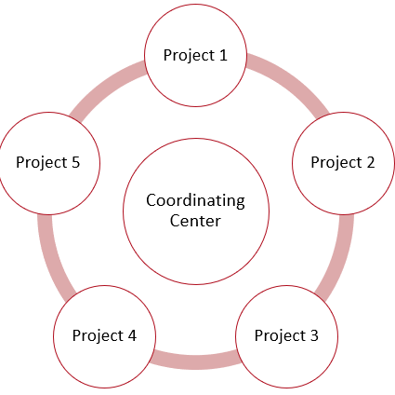
Network Purpose
The Health Equity Research Network (HERN) mechanism provides AHA an opportunity to address key strategic issues as determined by the AHA Board of Directors. Each network connects academic institutions and community organizations to address adverse social determinants of health and advance care for impacted communities.
The Maternal Infant Health HERN focused on understanding and addressing factors resulting in disproportionate pregnancy-related health outcomes in Black, Native American, and rural communities.
Notes:
Structural racism is linked to poor health and premature death from cardiac disease and stroke. In 2021, the American Heart Association pledged over $230 million in funding to support initiatives aimed at breaking down barriers to equity in healthcare. With this goal came the inception of the Health Equity Research Networks (HERN). This mechanism provides AHA an opportunity to address key strategic issues as determined by the AHA Board of Directors. Each network connects academic institutions and community organizations to address adverse social determinants of health and advance care for impacted communities.
The AHA committed $20 million to establish this specific Health Equity Research Network (HERN), which provides an opportunity to significantly advance our understanding of the factors underlying the disproportionate impact of maternal mortality and morbidity on Black women, Native American women, and those living in rural areas. Because heart and vascular issues account for about half of these deaths, the AHA is uniquely positioned to address this critical issue.

Slide 3

Diversity and Inclusion
In keeping with AHA’s core values of diversity and inclusivity, AHA is committed to broadening the diversity of investigators supported by programmatic, multi-investigator initiatives it offers.
As such, at least 25% of key personnel of the research team were required to be from groups who are under-represented in science and medicine.
At least 50% of the trainees named to each project were required to be from a racial or ethnic group that is under-represented in science
Notes:
In keeping with AHA’s core values of diversity and inclusivity, AHA is committed to broadening the diversity of investigators supported by programmatic, multi-investigator initiatives it offers.
At least 25% of key personnel of the research team must be from a group that is under-represented in science and medicine (Black/African-American; Hispanic/Latino; Native American or Alaska Native; Hawaiian or other Pacific Islander; LGBTQ+; women). Projects with principal investigators who are under-represented in science and medicine were also strongly encouraged.
Each Project MUST name at least two full-time (≥75% FTE) pre- or postdoctoral trainees during the award term. At least 50% of the trainees named to each project must be from a racial or ethnic group that is under-represented in science (Black/African-American; Hispanic/Latino; American Indian or Alaska Native; and/or Hawaiian or other Pacific Islander), an LGBTQ+ person, or a woman.

Slide 4
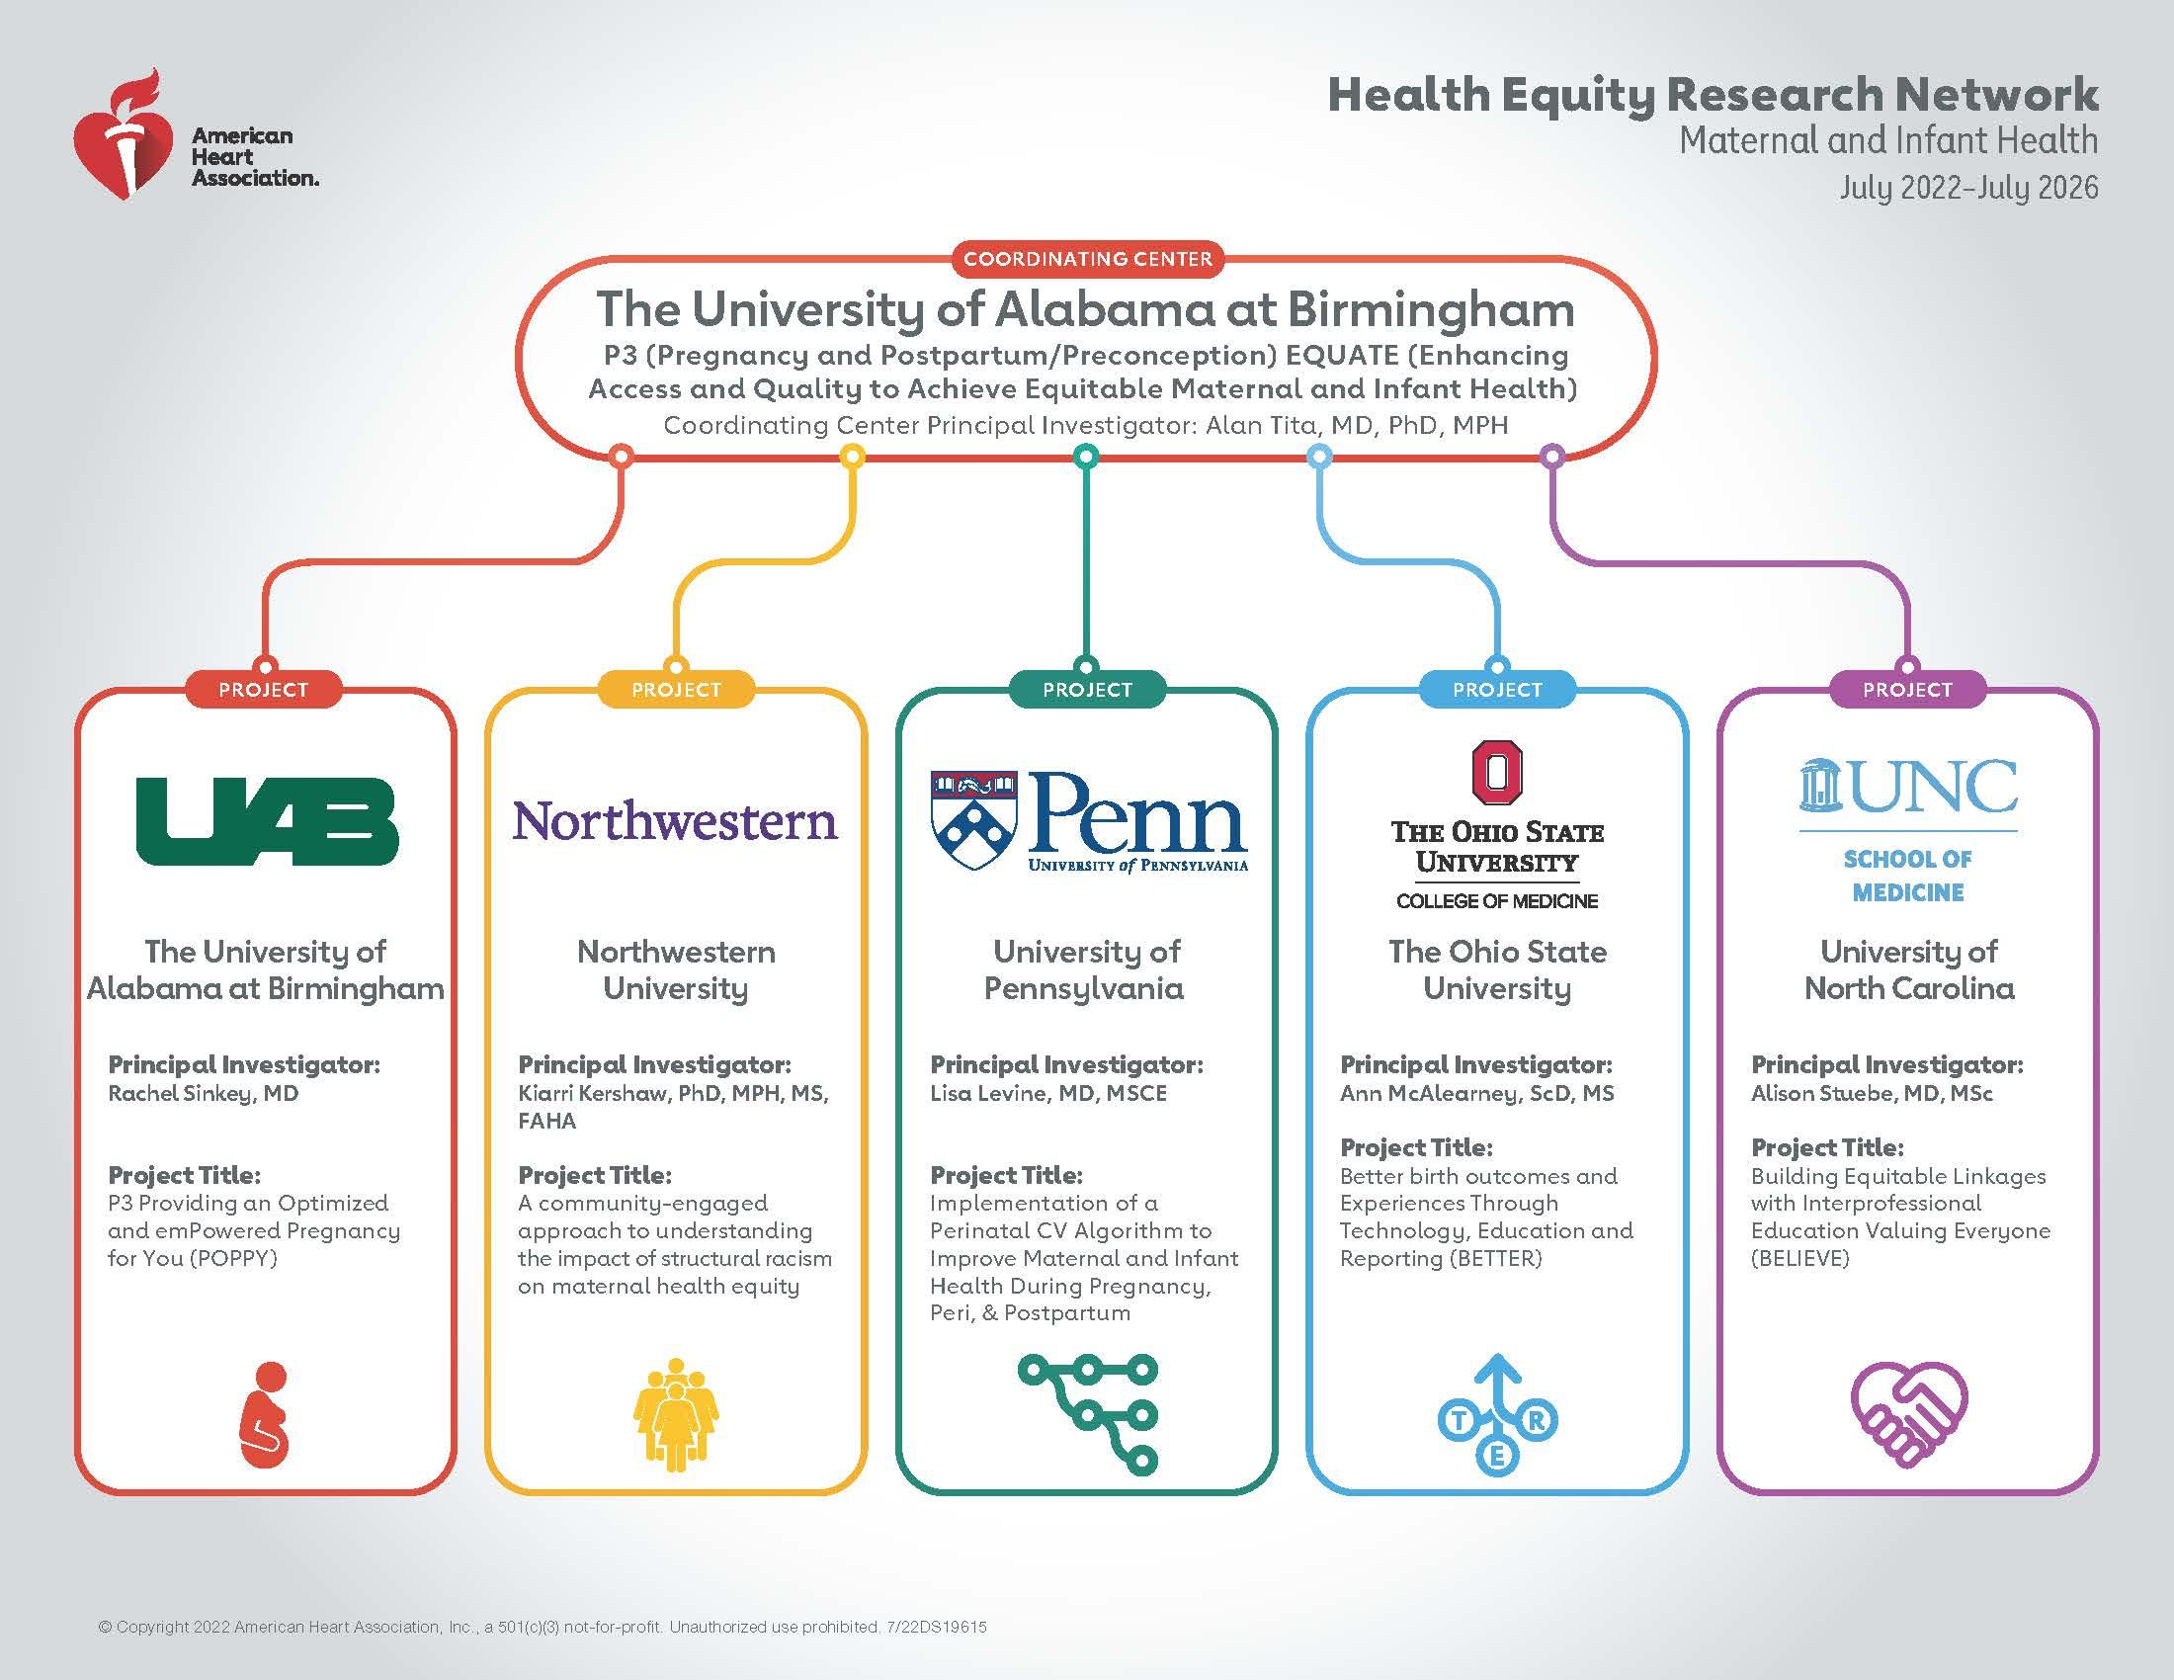
Notes:
This is the Maternal Infant Health’s at-a-glance of the institutions that were funded including their research focus. This network was funded $20 million which includes one coordinating center and 5 targeted research projects. The network began on July 1, 2022, and will run for four years.
University of Alabama at Birmingham (POPPY): Examine the impact of a digital health intervention and a community health worker intervention on pregnancy health outcomes.
Northwestern University (DREAM): Devise a method to measure the impact of structural racism on Black-white inequities in pregnancy and maternal-infant health.
University of Pennsylvania (IMPACT): Establish a cardiovascular risk assessment for pregnant and postpartum patients to reduce cardiovascular-related mortality during pregnancy.
The Ohio State University College of Medicine (BETTER): Develop an intervention to mitigate the social issues that contribute to poor maternal-infant health outcomes.
University of North Carolina School of Medicine (BELIEVE): Transform health services to be more equitable and personal by developing a training program for medical personnel to counter race-based disparities.

Slide 5
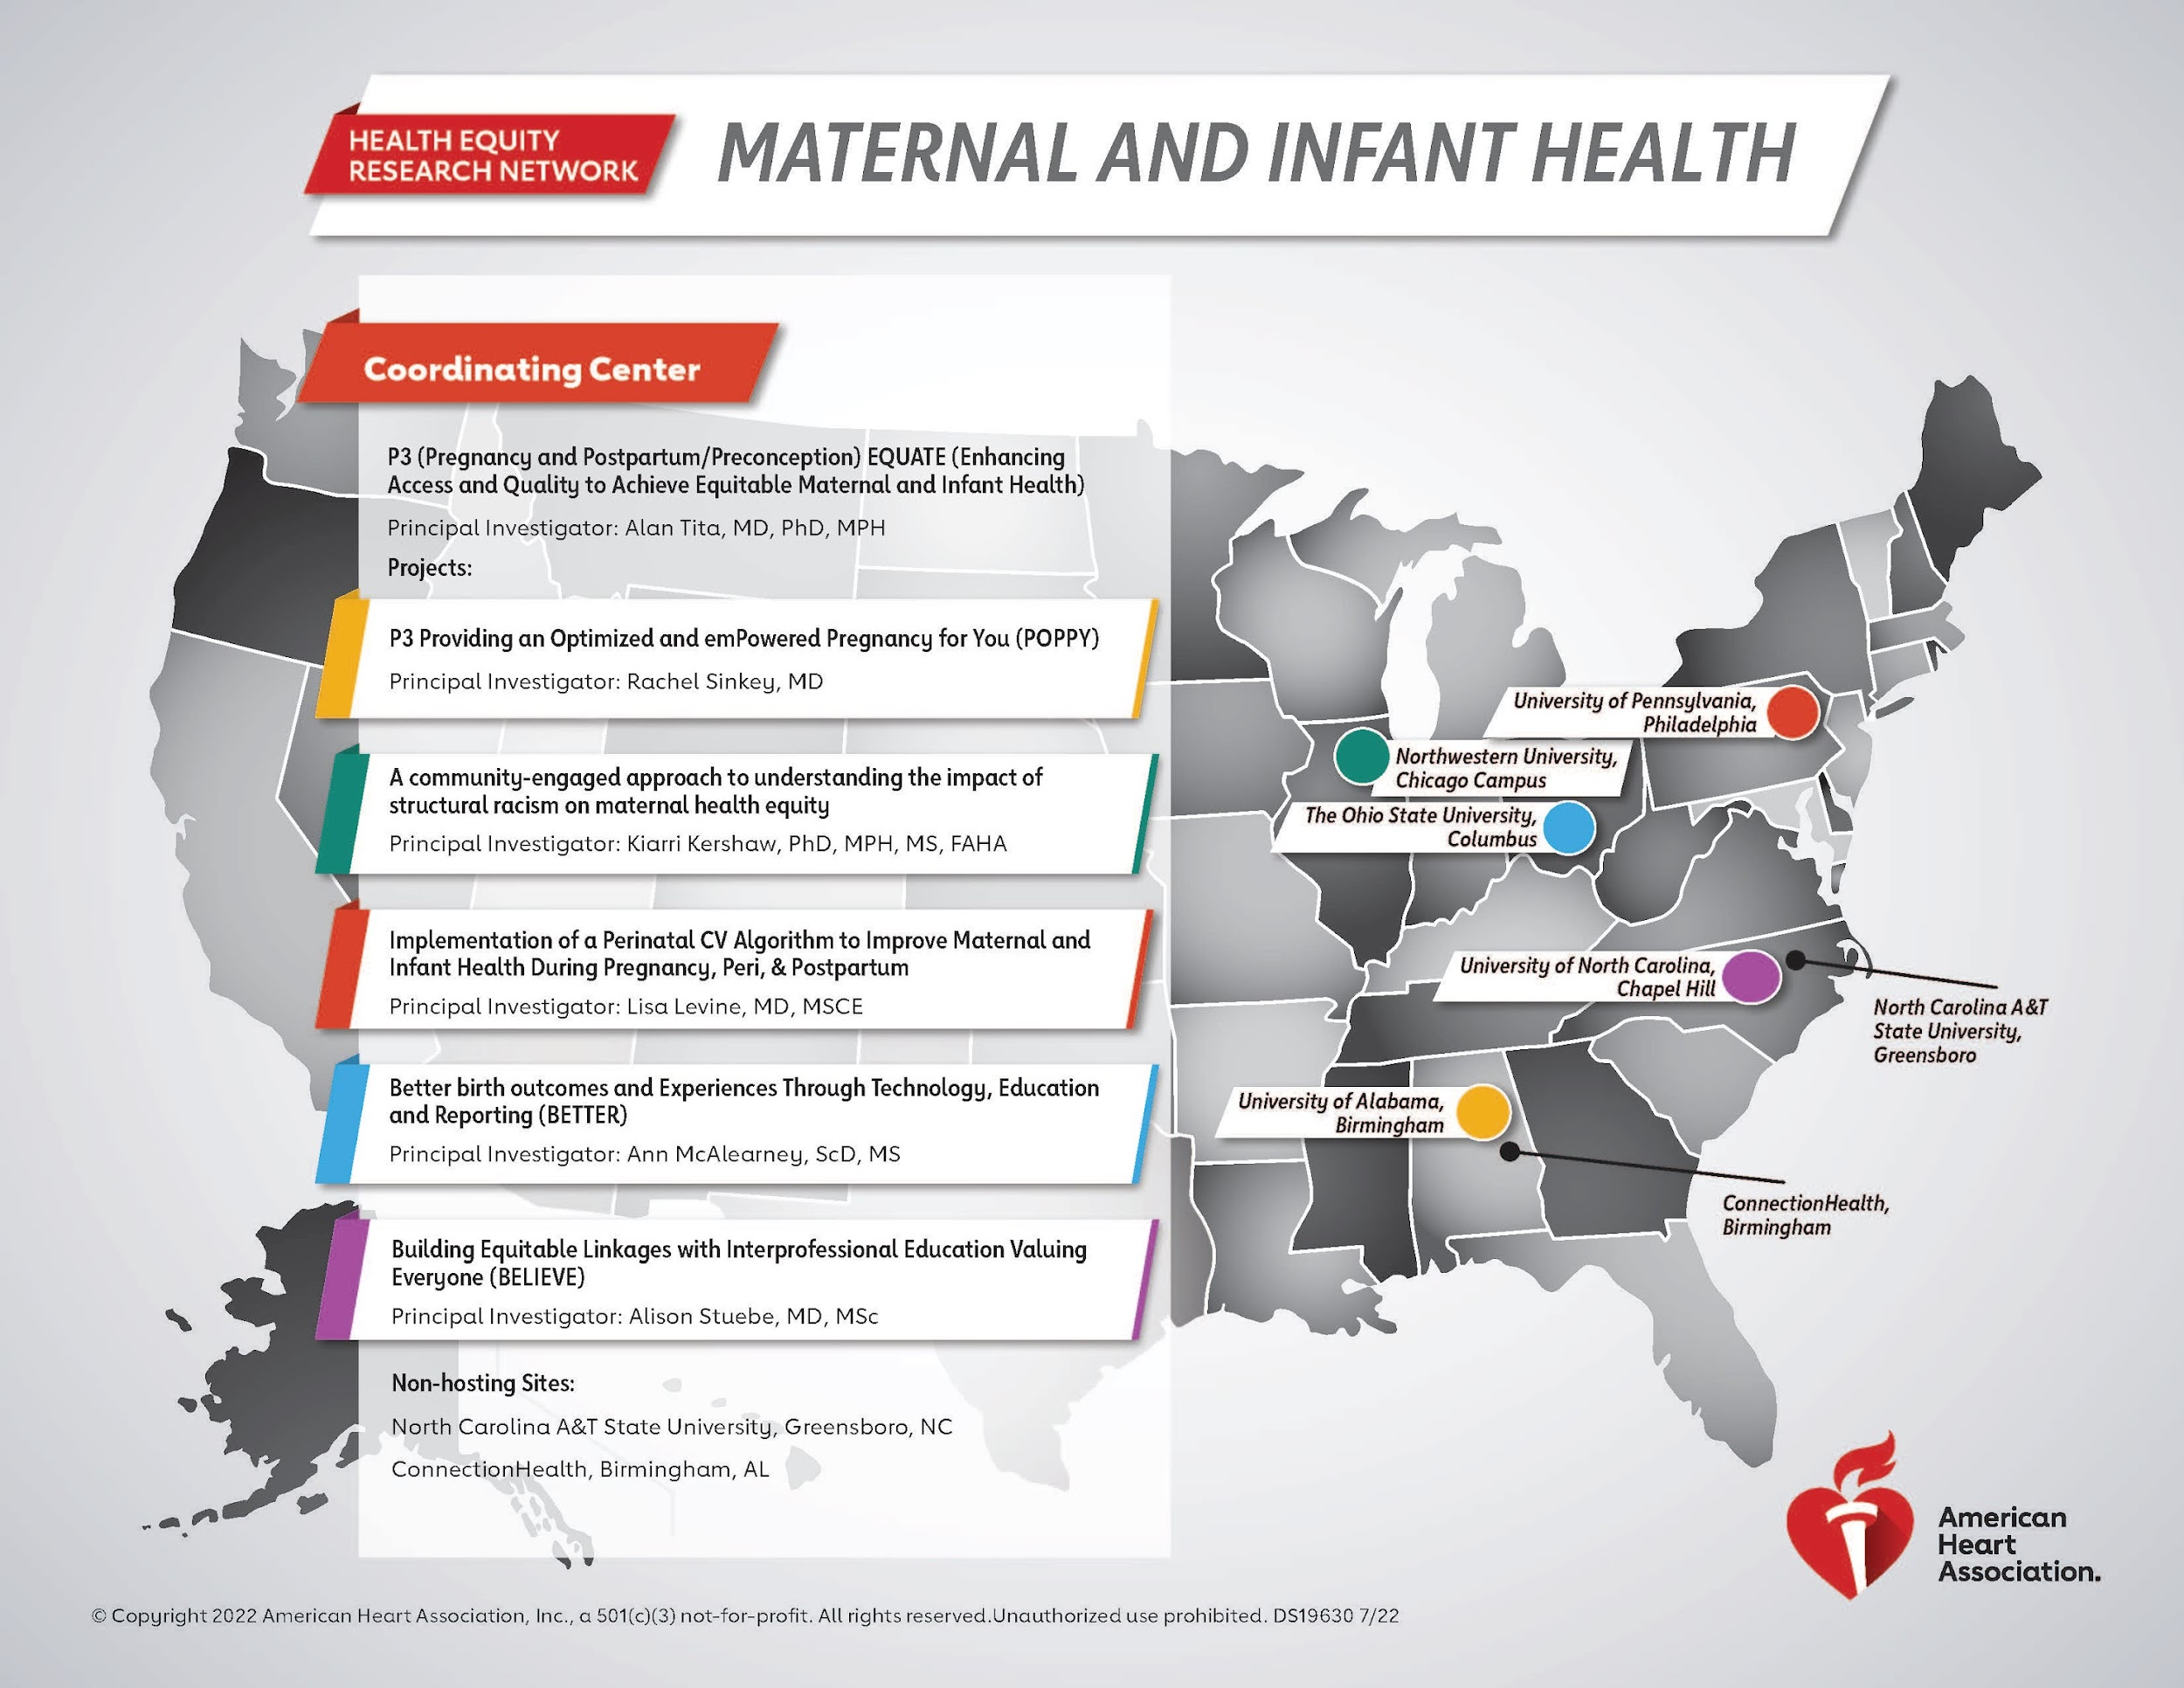
Notes:
This it the Maternal Infant Health HERN map that shows some of the partnering institutions that the network aligned with at the beginning of the network.

Slide 6

Oversight Advisory Committee
Each network has a dedicated Oversight Advisory Committee (OAC) that oversees the science and research to ensure the progress & success of each of the networks. The members are leading established investigators that are experienced in the area of the awarded research networks, but who are not funded by a program.
Notes:
Each network has a dedicated oversight advisory committee that oversees the science and research to ensure the progress & success of each of the networks. There are typically 9-12 volunteer members that make up the committee for each network. The members are leading established investigators that are experienced in the area of the awarded research networks, but who are not funded by a program.

Slide 7
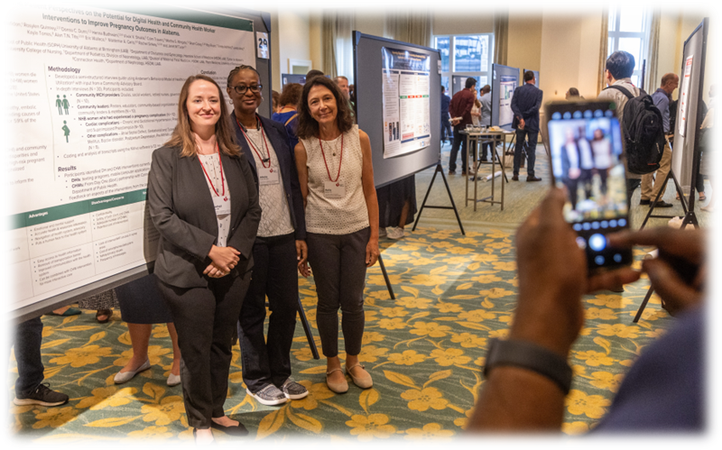

P3 EQUATE Network
The overriding goal of P3 EQUATE is to achieve equity in Maternal and Infant Health Outcomes by identifying innovative, scalable and sustainable strategies to enhance timely access to quality health information, care and experiences, during the pregnancy, postpartum/preconception and postnatal periods, particularly for Black and underserved populations.
Notes:
The Maternal Infant Health HERN refers to themselves as the P3 Equate Network which stands for Pregnancy, Postpartum, and Postnatal Health Enhancing Access and Quality to Achieve Equitable Maternal and Infant Health.
The HERN MIH is beginning the 3rd year of their award.
Their aims include:
Aim 1: Work with communities, health systems and/or pregnant/postpartum persons to develop strategies to improve maternal and infant health outcomes by addressing barriers related to structural racism and unfavorable social determinants of health (SDoH).
Aim 2: Evaluate the impact (effectiveness and implementation) on maternal and infant outcomes of strategies that enhance access and quality health care, information, and experiences.
Aim 3: Collaborate network-wide to analyze and disseminate findings that inform policy and engage multiple stakeholders including professional organizations, payors/funders, departments of health, and other authorities to advocate for guidelines, policies, and funding for scalable and sustainable interventions to advance maternal and infant health equity.
Aim 4: Train the next generation of transdisciplinary diverse scholars focusing on maternal and infant health equity research.

Slide 8
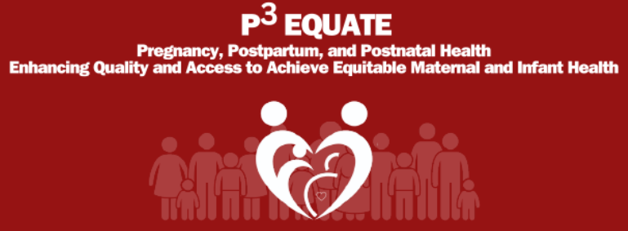
Coordinating Center:
University of Alabama at Birmingham
Pregnancy, Postpartum, and Postnatal Health Enhancing Access and Quality to Achieve Equitable Maternal and Infant Health. Also known as P3 Equate.
Under the direction of the Coordinating Center PI Dr Alan Tita: The Coordinating Center assembled national experts of different backgrounds to work together in 5 cores, collaborate with the 5 ongoing projects evaluating ways and approaches to reduce maternal and infant deaths, and develop trainees.
The P3 Equate Center has partnered with several entities including: Purdue Health Equity Initiatives, March of Dimes, Centering Healthcare Institute, Before the Birthplan, North Carolina A&T, and Charles Drew University.
Notes:
Under the direction of the Coordinating Center PI Dr Alan Tita: The Coordinating Center assembled national experts of different backgrounds to work together in 5 cores, collaborate with the 5 ongoing projects evaluating ways and approaches to reduce maternal and infant deaths, and develop trainees. To facilitate collaboration and progress towards the goals of the network, they accomplished the following activities to increase opportunities for collaboration and progress towards creating and disseminating resources: Launched the EQUATE pilot grant mechanism to seed opportunities for future collaboration, Quarterly newsletters to increase exchange of information, Quarterly network-wide meetings including project updates and relevant lecture including a talk from former surgeon general, Engaged with the EQUATE advisory board to plan for extending and maximizing the future impact of the network, Developed study reports in collaboration with AHA, Operationalized a data safety and monitoring board, Increased collaboration with AHA health equity research networks and with other networks/organizations, Enhanced opportunities for networking and collaboration during our semiannual and annual network meetings, Laid groundwork for future Network publications.
The P3 Equate Center has partnered with several entities including: Purdue Health Equity Initiatives, March of Dimes, Centering Healthcare Institute, Before the Birthplan, North Carolina A&T, and Charles Drew University.

Slide 9
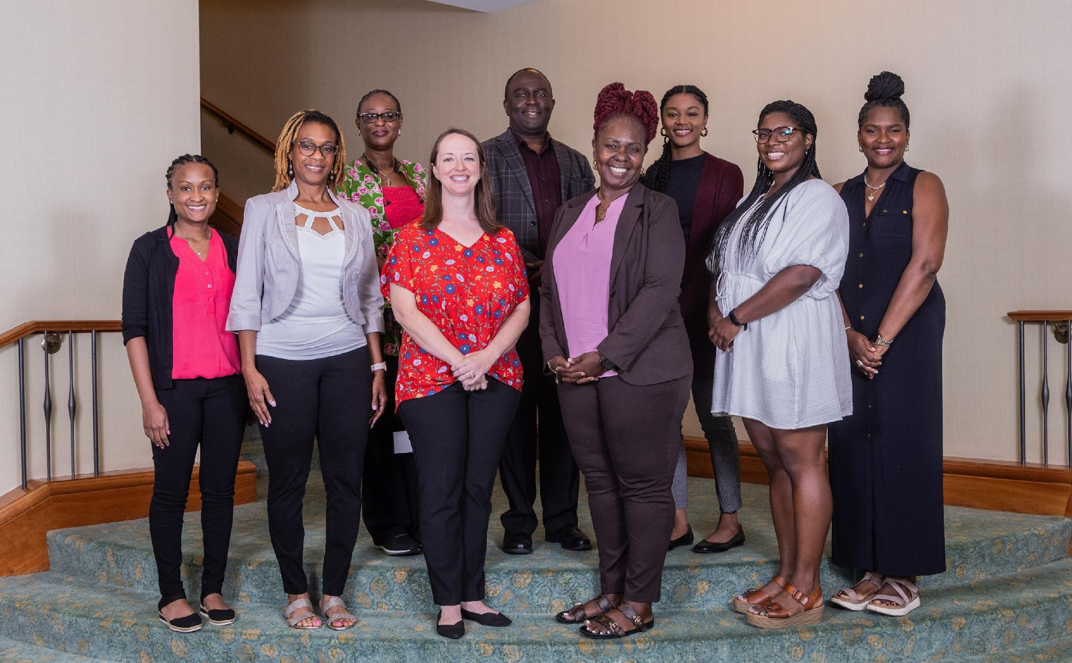
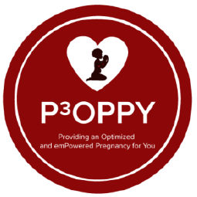
University of Alabama at Birmingham
The University of Alabama at Birmingham Project: Providing an Optimized and emPower Pregnancy for You. Also known as POPPY.
The POPPY project is examining the impact of a digital health intervention and a community health worker intervention on pregnancy health outcomes.
The POPPY Project has partnered with multiple entities including: ConnectionHealth, Memora, Khiari and Little Angels Memorial, The Preeclampsia Foundation, and North Carolina A&T State University.
Notes:
The University of Alabama at Birmingham Project: Providing an Optimized and emPower Pregnancy for You. Also known as POPPY is led by PI Dr. Rachel Sinkey.
US maternal mortality and preterm birth rates are among the highest in the developed world due, at least in part, to a combination of racial, regional, and socioeconomic disparities. Our preliminary work demonstrates that differences in the Area Deprivation Index (ADI) are associated with racial/ethnic disparities in maternal and perinatal outcomes in Alabama. The purpose of the P³ Providing an Optimized and emPowered Pregnancy for You (P³OPPY) study is to evaluate promising interventions to reduce disparities and improve health care access and quality among pregnant women and their infants from historically marginalized communities. They will test the hypothesis that an innovative mobile-health integrated care model and/or a community health worker integrated care model will improve pregnancy outcomes among women who experience persistent disparities.
They have ongoing collaborations with entities outside of the Network including: ConnectionHealth, Memora, Khiari and Little Angels Memorial, The Preeclampsia Foundation, and North Carolina A&T State University.

Slide 10
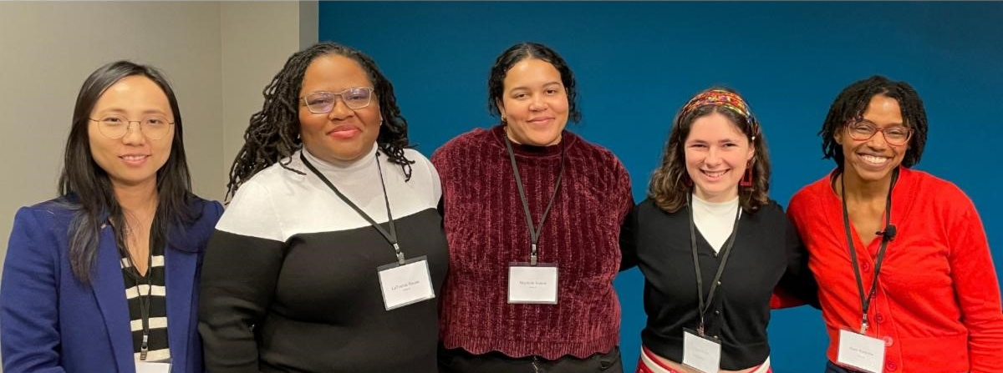

Northwestern University
The Northwestern University Project: Was originally a community engaged approach to understanding the impact of structural racism on maternal health equity. Has since updated to Dismantling structural Racism to promote EquitAble outcomes. Also known as DREAM.
The DREAM project is devising a method to measure the impact of structural racism on Black-white inequities in pregnancy and maternal-infant health.
The DREAM project has worked with diverse community-based organizations including: Reaching Our Sisters Everywhere (ROSE), Vision of Wellness, Washingtonian Problems, Birth Sister Doula Services.
Notes:
The Northwestern University Project: Was originally a community engaged approach to understanding the impact of structural racism on maternal health equity. Has since updated to Dismantling structural Racism to promote EquitAble outcomes. Also known as DREAM. The DREAM Project led by PI Dr. Kiarri Kershaw.
Black-White differences in the health of mothers and babies are one of the largest health inequities in the US. Early birth, low birth weight, and high blood pressure during pregnancy can all negatively impact the health of mother and baby. Structural racism is thought to be to be a major factor contributing to theses Black-White differences in health. But there is still not a clear definition of structural racism that shows how it impacts health. The overall goal of this project is to work with a geographically diverse group of pregnant and birthing persons, community organizations and other stakeholders to identify the most salient approaches to address the adverse impact of exposure to structural racism on Black-White inequities in adverse pregnancy outcomes and CVD risk.
The DREAM Project originally proposed only conducting focus groups with pregnant and postpartum participants in order to build a measure of structural racism. But they realized that they needed a more holistic approach in order to truly better understand how structural racism impacts pregnancy and postpartum experiences. They are expanding data collection in order to also interview leaders and front-line workers of community-based organizations that provide support to Black pregnant and postpartum clients (services include housing, education, employment, criminal justice, neighborhood development/economic investment, and health). They will also be conducting focus groups with community-based providers that provide health or health-related services to Black pregnant and postpartum clients (e.g. midwives, doulas, community health workers, etc.). With data from all three groups, they will use this information to develop a measure of structural racism.
The DREAM project has worked with diverse community-based organizations including: Reaching Our Sisters Everywhere (ROSE), Vision of Wellness, Washingtonian Problems, Birth Sister Doula Services.

Slide 11


University of Pennsylvania
The University of Pennsylvania Project: Implementation of a Perinatal CV Algorithm to Improve Maternal and Infant Health During Pregnancy, Peri, and Postpartum. Also known as IMPACT.
The IMPACT project is establishing a cardiovascular risk assessment for pregnant and postpartum patients to reduce cardiovascular-related mortality during pregnancy
The IMPACT project has partnered with multiple entities: ObGyn Department Summer Pipeline program, Oshun Family Center, and Odyssey of Eden Doula Services.
Notes:
The University of Pennsylvania Project: Implementation of a Perinatal CV Algorithm to Improve Maternal and Infant Health During Pregnancy, Peri, and Postpartum. Also known as IMPACT is led by PI Dr. Lisa Levine.
Black mothers are much more likely to die due to pregnancy than non-Hispanic white mothers. Cardiovascular (CV) related deaths are the largest contributor to peripartum mortality, specifically delayed response, ineffective care, and misdiagnosis. A guideline to help identify heart conditions in pregnant mothers was developed and if used correctly, it can identify most CV-related deaths before they occur, however, when applied in the hospital it didn’t work. This was likely due to people not knowing why doctors didn’t use the test or why patients may not be able to get the recommended blood test or other doctor-recommended follow-up care. The goal of the study is to identify the easiest way for doctors to integrate the existing guidelines into the health system workflow and figure out how to best ensure patients identified as at-risk receive the appropriate testing and follow-up care.
The IMPACT project has partnered with multiple entities: ObGyn Department Summer Pipeline program, Oshun Family Center, and Odyssey of Eden Doula Services.
https://vimeo.com/910911359/f2a1d0009e

Slide 12
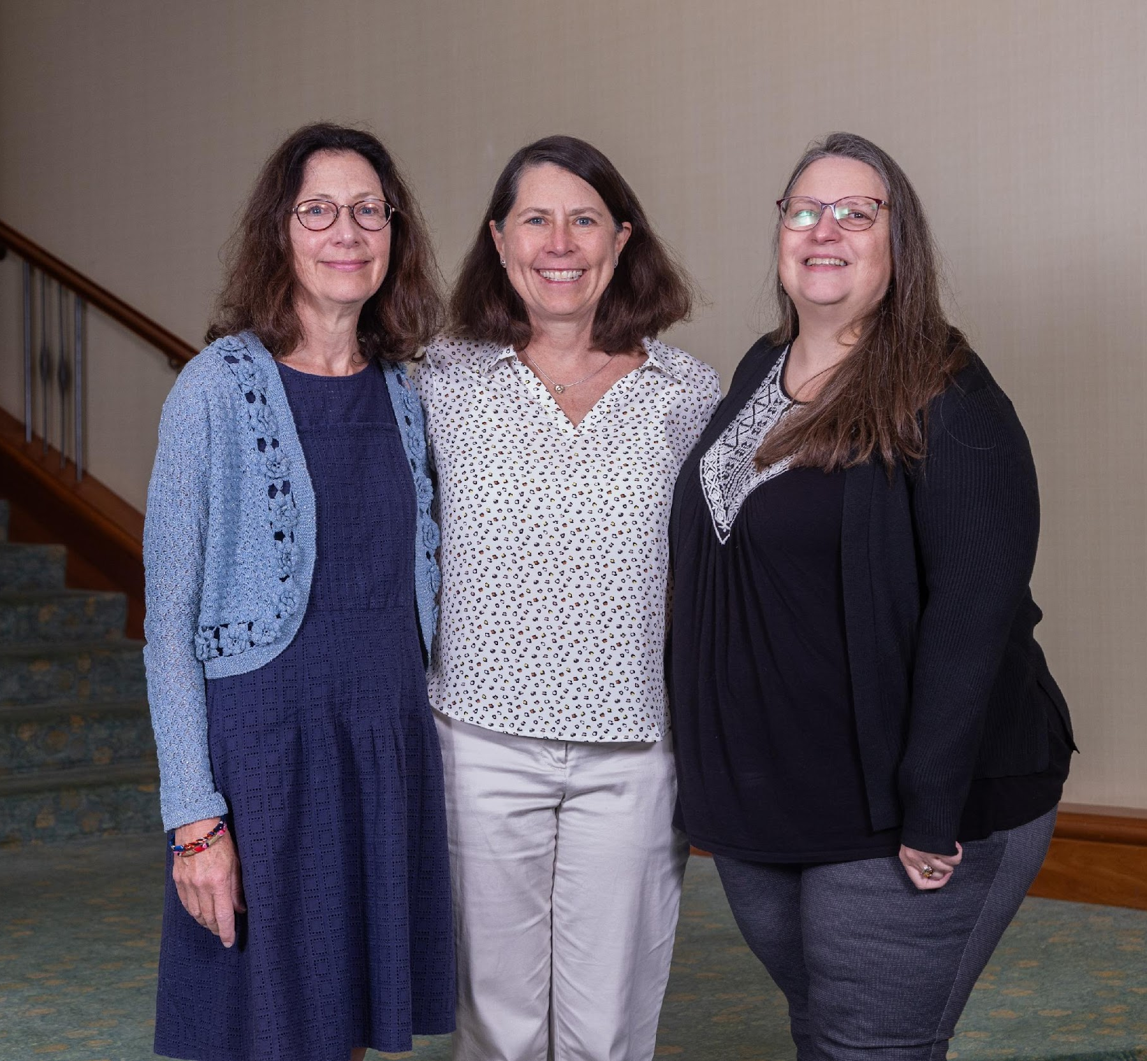

The Ohio State University
The Ohio State University Project: Better birth outcomes and Experiences Through Technology, Education and Reporting. Also known as BETTER.
The BETTER project is developing an intervention to mitigate the social issues that contribute to poor maternal-infant health outcomes.
The BETTER project is collaborating with Health Impact Ohio’s Central Ohio Pathways HUB and Queen’s Village.
Notes:
The Ohio State University Project: Better birth outcomes and Experiences Through Technology, Education and Reporting. Also known as BETTER is led by PI Dr. Ann McAlearney
It is well known that Black mothers have more health problems during pregnancy than White mothers. These differences may be because of social problems, such as not having a place to live, not having enough food, or living with crime and violence. The BETTER team thinks that if they can learn about and help people with these problems when they are pregnant, mothers and their babies will be healthier. They will work closely with pregnant people to learn from them about the problems they see as most important, and how they would like to convey those issues during their care. They will also talk to doctors and nurses to understand how they would like to learn about these issues as they care for pregnant people. Using the information gained the BETTER study will design and test a new way to improve the health of pregnant people and their babies, by addressing their social issues.
The BETTER project is collaborating with Health Impact Ohio’s Central Ohio Pathways HUB and Queen’s Village.

Slide 13
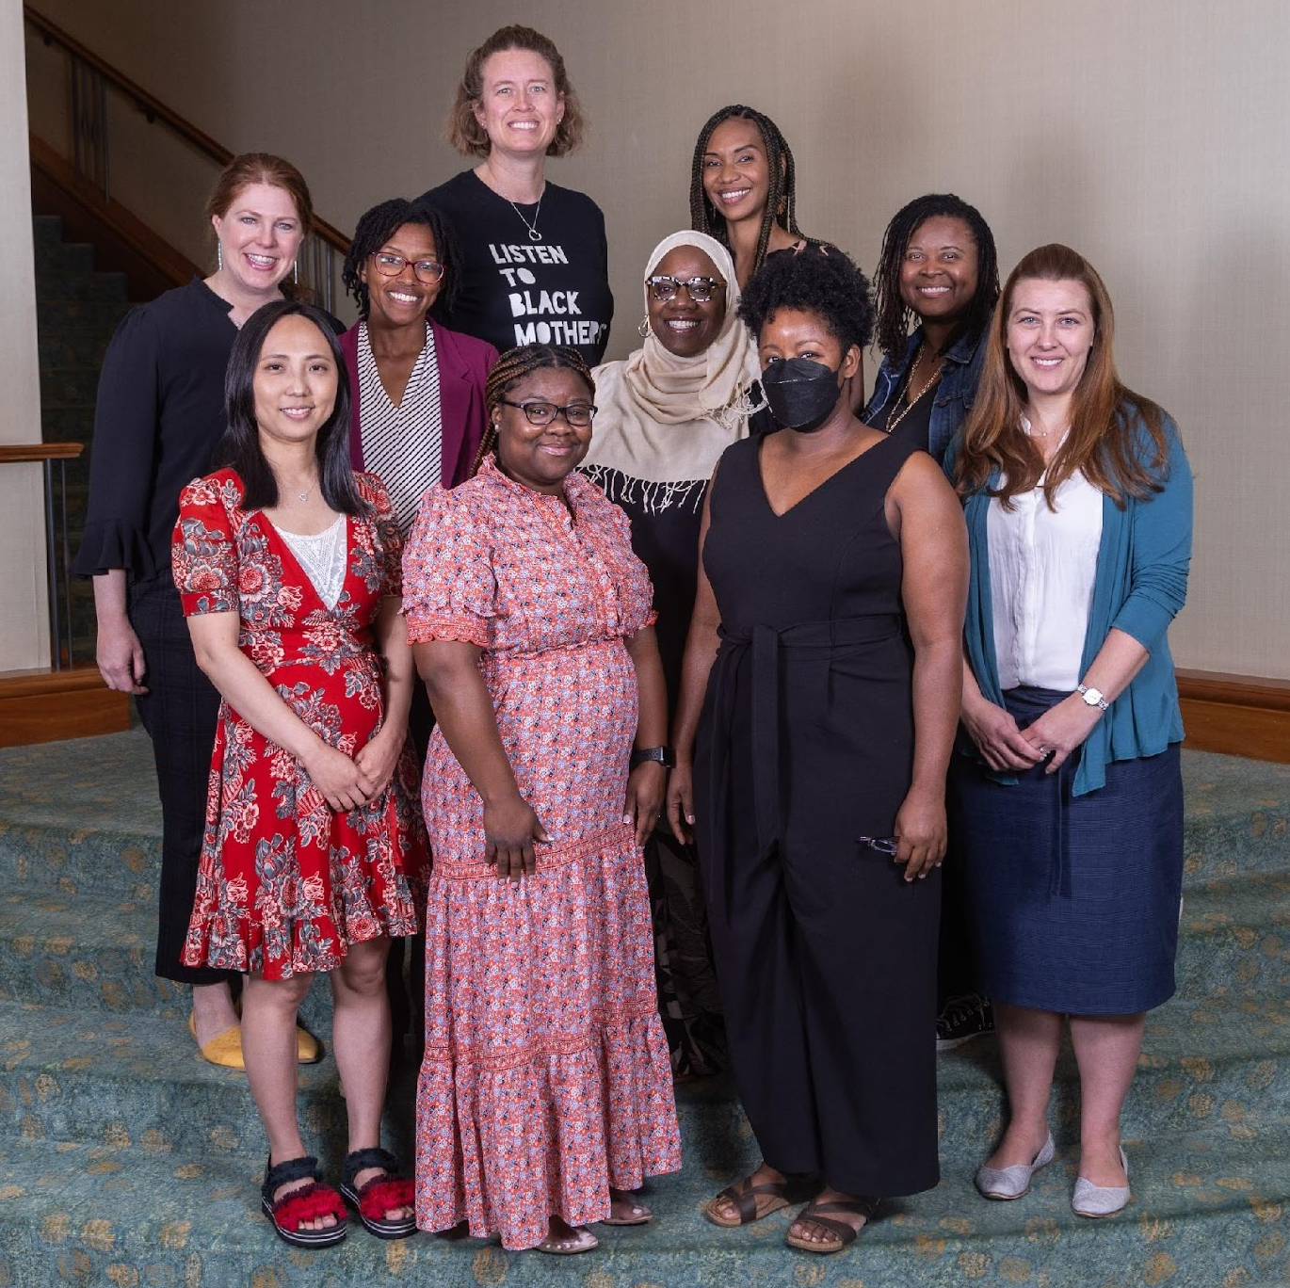

University of North Carolina
The University of North Carolina Project: Building Equitable Linkages with Interprofessional Education Valuing Everyone. Also known as BELIEVE.
The BELIEVE project is working to transform health services to be more equitable and personal by developing a training program for medical personnel to counter race-based disparities.
The BELIEVE project has partnered with multiple entities: The Heart Truth, Shades of Blue, High Schools in Winston Salem North Carolina, STEM programs, North Carolina Central University, and North Carolina Institute of Medicine Legislative Health Policy Fellows
Notes:
The University of North Carolina Project: Building Equitable Linkages with Interprofessional Education Valuing Everyone. Also known as BELIEVE is led by PI Dr. Allison Stuebe
The United States has unacceptable rates of morbidity and mortality, and unacceptable disparities. Remediating these disparities requires holistic solutions that include collaborative, multidisciplinary, multilevel models of maternity and perinatal care. The overall goal of the work is to transform health services so that each mother, birthing person, and health team member is seen, heard, and valued. Using Kirkpatrick’s Model, the BELIEVE team will work with community and health team members to develop a curriculum for interprofessional education and collaboration that cultivate trust among birthing people and health team members through respectful, equitable and person-centered care and communication. The BELIEVE curriculum will create spaces for rebuilding trust and healing from birth-related trauma and professional moral injury.
The BELIEVE project has partnered with multiple entities: The Heart Truth, Shades of Blue, High Schools in Winston Salem North Carolina, STEM programs, North Carolina Central University, and North Carolina Institute of Medicine Legislative Health Policy Fellows

Slide 14
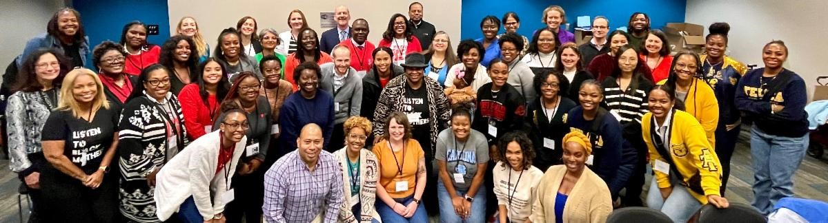
Thank You!

